Slide 1
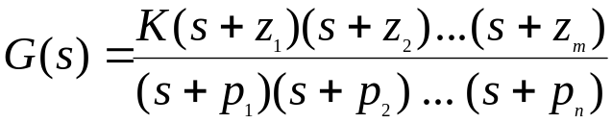
Poles and Zeros and Transfer Functions
Transfer Function:
A transfer function is defined as the ratio of the Laplace
transform of the output to the input with all initial
conditions equal to zero. Transfer functions are defined
only for linear time invariant systems.
Considerations:
Transfer functions can usually be expressed as the ratio
of two polynomials in the complex variable, s.
Factorization:
A transfer function can be factored into the following form.
The roots of the numerator polynomial are called zeros.
The roots of the denominator polynomial are called poles.
wlg

Slide 2
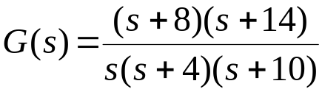
Poles, Zeros and the S-Plane
An Example:
You are given the following transfer function. Show the
poles and zeros in the s-plane.
jω
axis
S - plane
origin
o
x
o
x
x
-14
-10
-8
-4
0
σ axis
wlg

Slide 3
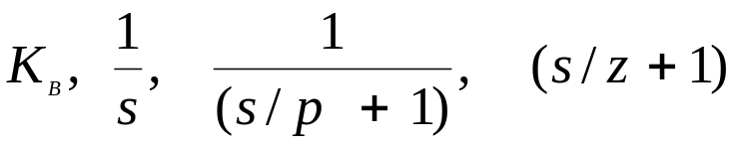
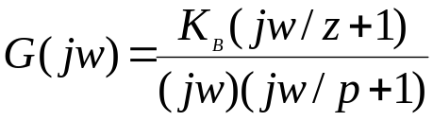
Poles, Zeros and Bode Plots
Characterization:
Considering the transfer function of the
previous slide. We note that we have 4 different
types of terms in the previous general form:
These are:
Expressing in dB:
Given the tranfer function:
wlg

Slide 4
Poles, Zeros and Bode Plots
Mechanics:
We have 4 distinct terms to consider:
20logK_{B}
20log|(jw/z +1)|
-20log|jw|
-20log|(jw/p + 1)|
wlg

Slide 5
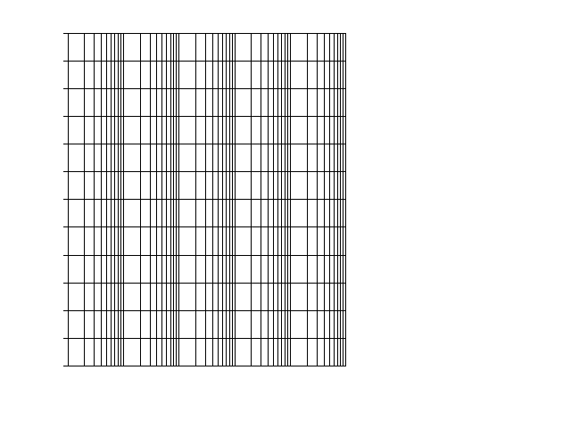
1 1 1 1 1 1
This is a sheet of 5 cycle, semi-log paper.
This is the type of paper usually used for
preparing Bode plots.
dB Mag
Phase
(deg)
wlg
ω (rad/sec)

Slide 6
Poles, Zeros and Bode Plots
Mechanics:
The gain term, 20logK_{B,} is just so many
dB and this is a straight line on Bode paper,
independent of omega (radian frequency).
The term, - 20log|jw| = - 20logw, when plotted
on semi-log paper is a straight line sloping at
20dB/decade. It has a magnitude of 0 at w = 1.
20
-20db/dec
0
-20
ω=1
wlg

Slide 7
Poles, Zeros and Bode Plots
Mechanics:
The term, - 20log|(jw/p + 1), is drawn with the
following approximation: If w < p we use the
approximation that –20log|(jw/p + 1 )| = 0 dB,
a flat line on the Bode. If w > p we use the
approximation of –20log(w/p), which slopes at
-20dB/dec starting at w = p. Illustrated below.
It is easy to show that the plot has an error of
3dB at w = p and – 1 dB at w = p/2 and w = 2p.
One can easily make these corrections if it is
appropriate.
20
0
-20db/dec
-20
-40
ω
= p
wlg

Slide 8
Poles, Zeros and Bode Plots
Mechanics:
When we have a term of 20log|(jw/z + 1)| we
approximate it be a straight line of slop 0 dB/dec
when w < z. We approximate it as 20log(w/z)
when w > z, which is a straight line on Bode paper
with a slope of + 20dB/dec. Illustrated below.
20
+20db/dec
0
-20
-40
ω
= z
wlg

Slide 9
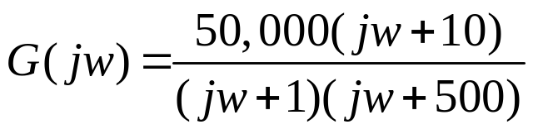
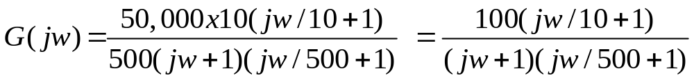
Example 1:
Given:
First: Always, always, always get the poles and zeros in a form such that
the constants are associated with the jw terms. In the above example
we do this by factoring out the 10 in the numerator and the 500 in the
denominator.
Second:
When you have neither poles nor zeros at 0, start the Bode
at 20log₁₀K = 20log₁₀100 = 40 dB in this case.
wlg

Slide 10
Example 1:
(continued)
Third: Observe the order in which the poles and zeros occur.
This is the secret of being able to quickly sketch the Bode.
In this example we first have a pole occurring at 1 which
causes the Bode to break at 1 and slope – 20 dB/dec.
Next, we see a zero occurs at 10 and this causes a
slope of +20 dB/dec which cancels out the – 20 dB/dec,
resulting in a flat line ( 0 db/dec). Finally, we have a
pole that occurs at w = 500 which causes the Bode
to slope down at – 20 dB/dec.
We are now ready to draw the Bode.
Before we draw the Bode we should observe the range
over which the transfer function has active poles and zeros.
This determines the scale we pick for the w (rad/sec)
at the bottom of the Bode.
The dB scale depends on the magnitude of the plot and
experience is the best teacher here.
wlg

Slide 11
Bode Plot Magnitude for 100(1 + jw/10)/(1 + jw/1)(1 + jw/500)
1 1 1 1 1 1
60
1 1 1 1 1 1
4
0
20
dB Mag
Phase (deg)
dB Mag
0
Phase (deg)
-20
-60
-60
ω (rad/sec)
0.1 1 10 100 1000 10000
ω (rad/sec)
wlg

Slide 12
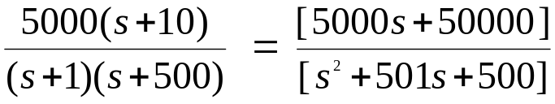
Using Matlab For Frequency Response
Instruction:
We can use Matlab to run the frequency response for
the previous example. We place the transfer function
in the form:
The Matlab Program
num = [5000 50000];
den = [1 501 500];
Bode (num,den)
In the following slide, the resulting magnitude and phase plots (exact)
are shown in light color (blue). The approximate plot for the magnitude
(Bode) is shown in heavy lines (red). We see the 3 dB errors at the
corner frequencies.
wlg

Slide 13
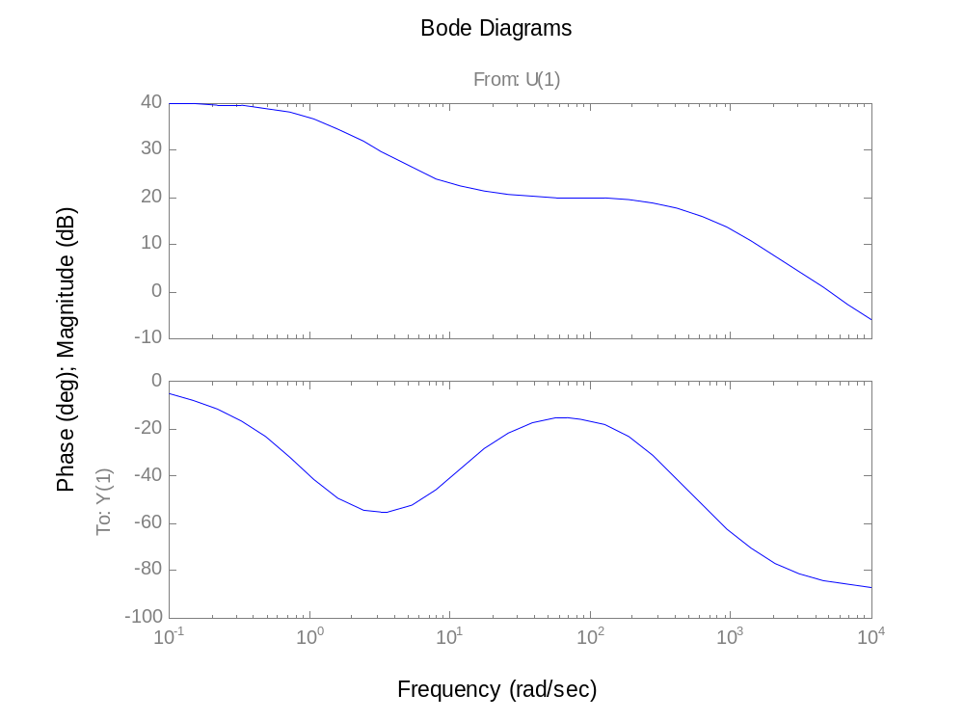
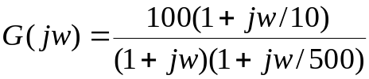
1
10
100
500
Bode for:
wlg

Slide 14
Phase for Bode Plots
Comment:
Generally, the phase for a Bode plot is not as easy to draw
or approximate as the magnitude. In this course we will use
an analytical method for determining the phase if we want to
make a sketch of the phase.
Illustration:
Consider the transfer function of the previous example.
We express the angle as follows:
We are essentially taking the angle of each pole and zero.
Each of these are expressed as the tan⁻¹(j part/real part)
Usually, about 10 to 15 calculations are sufficient to determine
a good idea of what is happening to the phase.
wlg

Slide 15
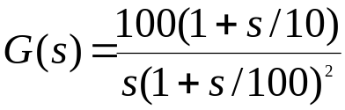

Bode Plots
Example 2:
Given the transfer function. Plot the Bode magnitude.
Consider first only the two terms of
Which, when expressed in dB, are; 20log100 – 20 logw.
This is plotted below.
The
is
40
a tentative line we use
until we encounter the
first pole(s) or zero(s)
not at the origin.
-20db/dec
dB
20
0
-20
wlg
1
ω (rad/sec)

Slide 16
Bode Plots
Example 2:
(continued)
The completed plot is shown below.
60
1 1 1 1 1 1
60
-20db/dec
40
40
20
20
Phase (deg)
dB Mag
-40 db/dec
Phase (deg)
dB Mag
0
0
-20
-20
-40
-40
-60
-60
0.1
0.1
1 10 100 1000
1 10 100 1000
wlg
ω (rad/sec)
ω (rad/sec)

Slide 17
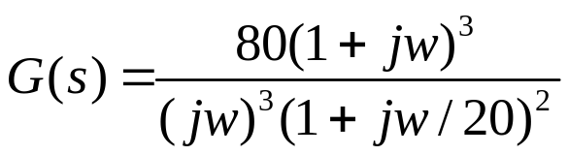
Bode Plots
Example 3:
Given:
20log80 = 38 dB
1 1 1 1 1 1
-60 dB/dec
60
dB Mag
40
-40 dB/dec
20
0
-20
.
0.1
1
10
100
wlg
ω (rad/sec)

Slide 18
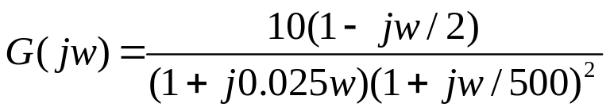
Bode Plots
Example 4:
Given:
1 1 1 1 1 1
60
40
+ 20 dB/dec
20
-40 dB/dec
dB Mag
Phase (deg)
0
-20
Sort of a low
pass filter
-40
-60
0.1
2
1 10 100 1000
wlg
ω (rad/sec)

Slide 19
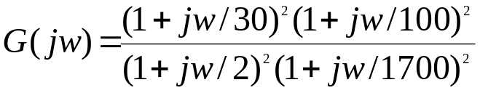
Bode Plots
Given:
Example 5
1 1 1 1 1 1
60
40
20
dB Mag
Phase (deg)
0
-40 dB/dec
Sort of a low
pass filter
-20
+ 40 dB/dec
-40
-60
0.1
1 10 100 1000
wlg
ω (rad/sec)

Slide 20
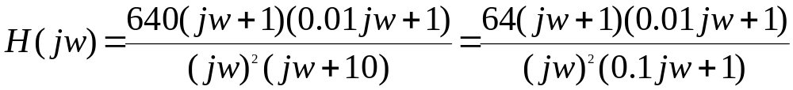
Bode Plots
Given:
problem 11.15 text
Example 6
.
-40dB/dec
40
.
-20db/dec
20
.
-40dB/dec
dB mag
0
-20
.
-20dB/dec
-40
.
0.1 1 10 100 1000
wlg
0.01

Slide 21
Bode Plots
Design Problem:
Design a G(s) that has the following Bode plot.
Example 7
40
30 dB
20
+40 dB/dec
-40dB/dec
0
dB mag
?
?
0.1
1
10
30
100
900
1000
wlg
ω rad/sec

Slide 22
Bode Plots
Procedure:
The two break frequencies need to be found. Recall:
Then we have:
#dec = log₁₀[w₂/w₁]
(#dec)( 40dB/dec) = 30 dB
log₁₀[w₁/30] = 0.75
w₁ = 5.33 rad/sec
Also:
log₁₀[w₂/900]
(-40dB/dec) = - 30dB
This gives w₂ = 5060 rad/sec
wlg

Slide 23
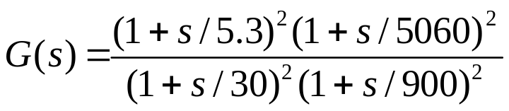
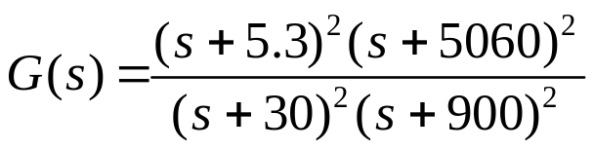
Bode Plots
Procedure:
Clearing:
Use Matlab and conv:
N1 = [1 10.6 28.1] N2 = [1 10120 2.56e+7]
N = conv(N1,N2)
1 1.86e+3 2.58e+7 2.73e+8 7.222e+8
s⁴ s³ s² s¹ s⁰
wlg

Slide 24
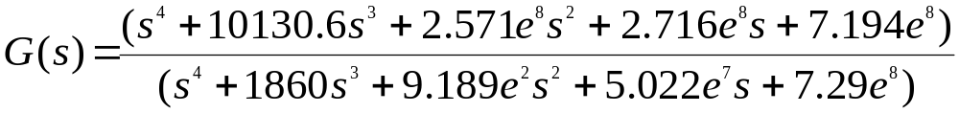
Bode Plots
Procedure:
The final G(s) is given by;
Testing:
We now want to test the filter. We will check it at ω = 5.3 rad/sec
And ω = 164. At ω = 5.3 the filter has a gain of 6 dB or about 2.
At ω = 164 the filter has a gain of 30 dB or about 31.6.
We will check this out using MATLAB and particularly, Simulink.
wlg

Slide 25
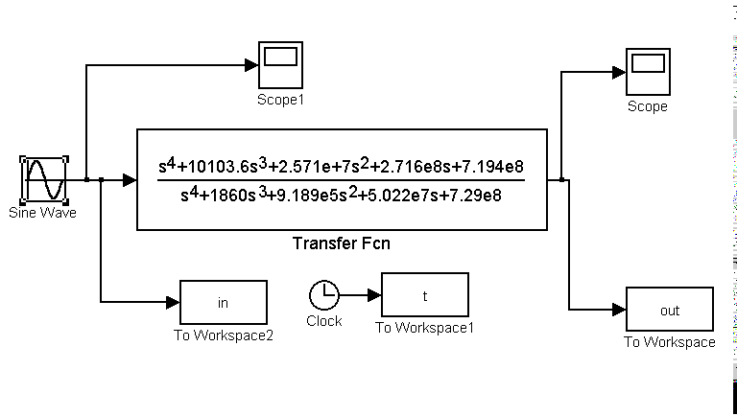
Matlab (Simulink) Model:
wlg

Slide 26
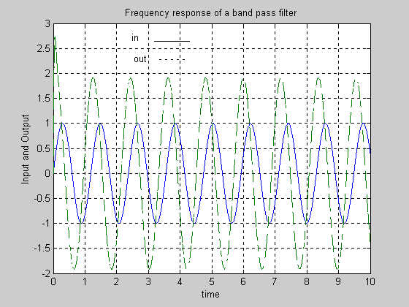
Filter Output at ω = 5.3 rad/sec
Produced from Matlab Simulink
wlg

Slide 27
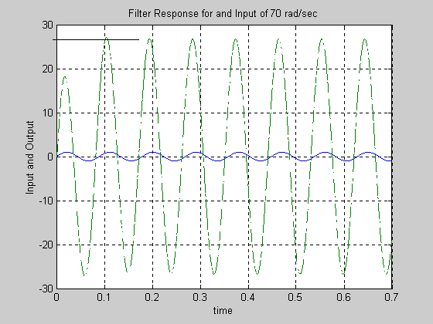
Filter Output at ω = 70 rad/sec
Produced from Matlab Simulink
wlg

Slide 28
Reverse Bode Plot
Required:
From the partial Bode diagram, determine the transfer function
(Assume a minimum phase system)
Example 8
Not to scale
68
20 db/dec
-20 db/dec
30
20 db/dec
dB
1
ω
110
850
wlg

Slide 29
Reverse Bode Plot
Required:
From the partial Bode diagram, determine the transfer function
(Assume a minimum phase system)
Example 9
100 dB
-40 dB/dec
Not to scale
50 dB
-20 dB/dec
-20 dB/dec
10 dB
-40 dB/dec
0.5
40
300
wlg
w (rad/sec)

Slide 30
Appendix

Slide 32
1 1 1 1 1 1
dB Mag
Phase
(deg)
ω (rad/sec)

